Slide 1
Practical lesson № 7
INJECTIONS. COMPLICATIONS

Slide 2
THEORETICAL QUESTION
Parenteral administration. Definition. Methods of the parenteral administrat. Advantage and Disadvantages.
Syringe. Classification of syringes.
Intradermal Injection. Definition. Purpose. Site of injection.
Subcutaneous Injection. Definition. Site of injection.
Intramuscular inject. Definition. Site of injection.
Intravenous injection. Definition. Site of injection. Factors complicating intravenous injection.
Possible complications after injection.
Infiltrate. Infiltrate. Causes. Clinic. Nursing care.
Abscess. Infiltrate. Causes. Clinic. Nursing care.
Long-term complications. Infiltrate. Causes. Clinic. Nursing care.
Thrombophlebitis. Infiltrate. Causes. Clinic. Nursing care.
Hematoma or hemorrhage. Infiltrate. Causes. Clinic. Nursing care.
Needle breakage. Infiltrate. Causes. Clinic. Nursing care.
Necrosis. Infiltrate. Causes. Clinic. Nursing care.
Air embolism. Infiltrate. Causes. Clinic. Nursing care.
Nerve damage. Infiltrate. Causes. Clinic. Nursing care.
Allergic reaction. Infiltrate. Causes. Clinic. Nursing care.
PRACTICAL SKILLS
Intradermal Injection.
Subcutaneous Injection.
Intramuscular inject.
Intravenous injection.
Preparation medicines (take out from an ampule)

Slide 3
Possible complications after injection:
Infiltrate
Abscess
Thrombophlebitis
Hematoma or hemorrhage
Needle breakage
Necrosis
Air embolism
Nerve damage
Allergic reaction
Long-term complications

Slide 4
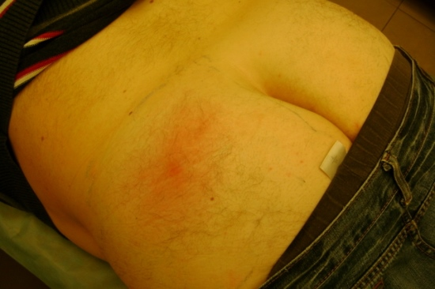
Infiltrate
Infiltrate - local inflammation of the soft tissues.
Causes:
violation of the asepsis rules
multiple injections in one place.
Clinic:
redness at the injection site,
induration,
swelling pain,
local temperature rise.
Nursing care:
tell your doctor
stop injections into this area,
hot compress or hot water bottle into the place of infiltration
physiotherapy

Slide 5
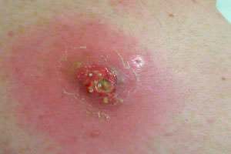
Abscess
Abscess - purulent inflammation of soft tissue with formation of a cavity filled with pus.
Causes:
gross violation of the asepsis rules
weakening of the immune system
multiple injections in one place
violation of the injection techniques
Clinic:
Severe pain at the injection site,
Induration,
Edema
Limited accumulation of pus
Total temperature rise.
Nursing care:
Tell your doctor
Follow the important doctor's prescriptions
Stop injection in this area
Dissection of abscess if necessary.

Slide 6
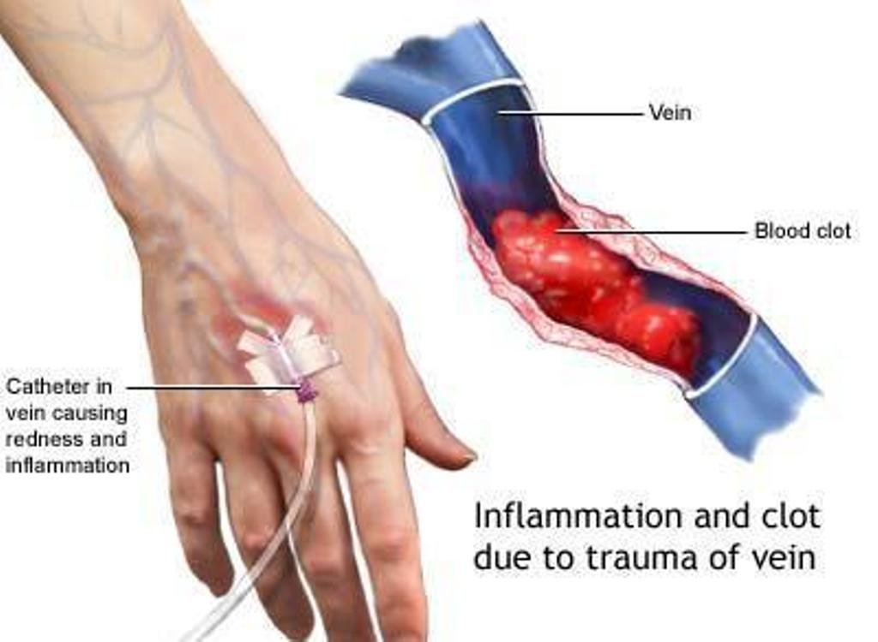
Thrombophlebitis
Thrombophlebitis - acute inflammation of the veins and the formation of an infected thrombus.
Causes:
gross violation of the rules of asepsis
multiple injections in one place
Clinic:
Redness of the skin at the injection site,
Swelling at the injection site,
Painful and tight vienna at a palpation,
Local temperature rise.
Nursing care:
tell the doctor,
follow the important doctor's prescriptions
stop injections in this area,
apply a hot compress,
physiotherapy,
ointment, improving blood rheology.

Slide 7
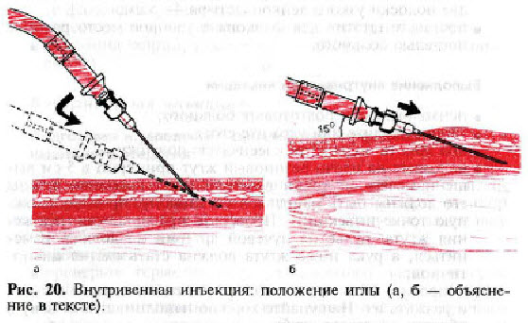
Hematoma or hemorrhage
Hematoma - bleeding under the skin. Most often this is the result of the intravenous injection.
Causes:
Violation of intravenous injection technique (insertion of the needle into the vein at an angle more 15° and the perforation of the two walls of the vein).
Clinic:
Painful in site of injection
Bluish skin in site of injection.
Nursing care:
Injection stop.
Press the damaged vein for a few minutes with a cotton ball with alcohol.
Hot compress
Introduction of the drug into another vein.

Slide 8
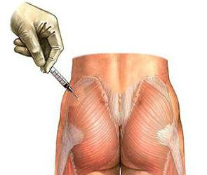
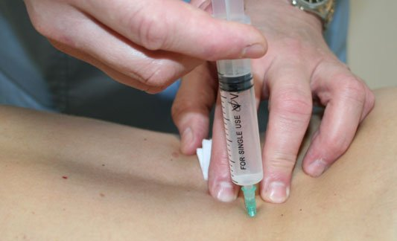
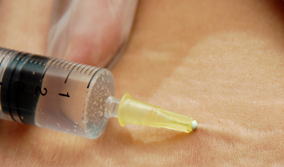
Needle breakage.
Causes:
sharp contraction of the muscle during an intramuscular injection in the standing position,
inserting of the needle at the entire depth.
Nursing care:
Quickly remove chip of the needle from the tissue with your fingers.
If the needle is completely in the tissue - immediately call a physician, preferably a surgeon.
Surgical intervention is required at such complication.

Slide 9
Necrosis
Necrosis – tissue death.
Causes:
insertion the drug substance with irritating properties in the soft tissue.
Clinic:
a sharp pain,
burning,
swelling at the injection site
blisters or ulcers
Nursing care:
1. Stop injection.
2. Introduce 0.5% solution of novocaine into injection site.
3. Put the ice pack on the injection site.
4. Tell your doctor.

Slide 10
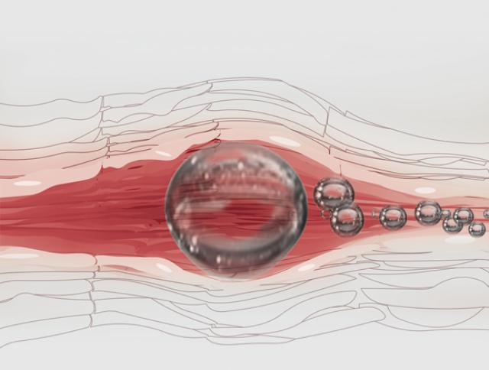
Air embolism
Air embolism - obstruction of vessels of the pulmonary circulation with air bubble. As a result of disturbed nutrition and surrounding tissue necrosis develops.
Causes:
insertion the drug substance with air
Clinic develops rapidly (within 1 minute). Symptoms of pulmonary vascular embolism:
Sudden attack of breathlessness
Cough
Pain in chest
blue upper body (cyanosis).
Treatment: absence of treatment.

Slide 11
Nerve damage
Causes:
Incorrect selection of injection site.
Clinic:
Pain,
violated function of limbs.
Treatment:
Call a physician to perform the prescribing physician.

Slide 12
Allergic reaction:
Type:
local reaction (urticaria),
general reaction (anaphylactic shock)

Slide 13
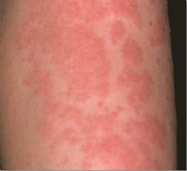
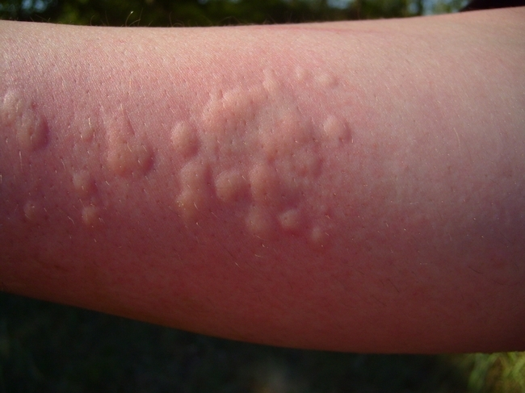
Urticaria
Clinic:
red itchy rash in various sizes.
The rash may be at the injection site or spread throughout the body.
Treatment:
Stop injection.
Call a physician.
Perform the prescribing physician.

Slide 14
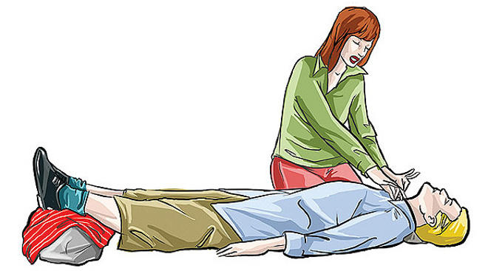
Anaphylactic shock. This is the most severe allergic reaction.
Clinic:
sudden feeling of weakness
laryngeal edema, shortness of breath,
decreased blood pressure,
a weak and rapid pulse
loss of consciousness.
Death can occur from acute respiratory failure, sometimes within a few minutes.
First aid
call a physician,
• put the patient on the back,
head turned to the side,
raise legs,
• inject 0.5 ml of epinephrine intramuscularly,
• carry out resuscitation, if necessary.

Slide 15
Long-term complications:
Sepsis (infection in the blood),
blood hepatitis (B, C),
HIV infection

